Slide 1
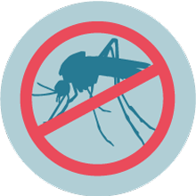
Prediction of mosquitos with West Nile Virus
04/22/2022 Hanpu Yao
MUSA capstone

Slide 2
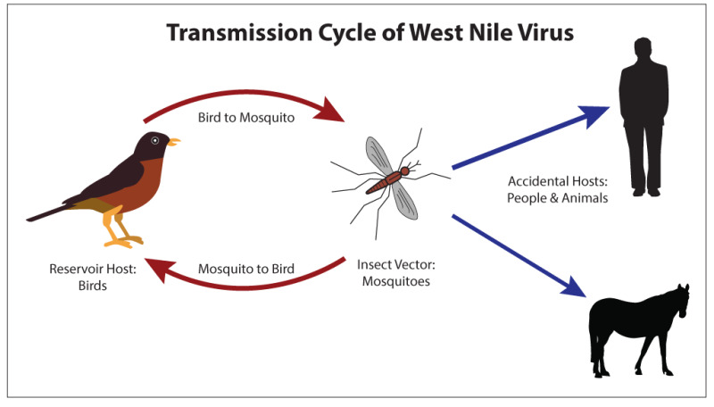
What is West Nile virus (WNV)
It is the leading cause of mosquito-borne disease in U.S.
It spreads to people by the bite of an infected mosquito.

Slide 3

Research question
Scale: City of Chicago
Goal: Predict the risk that WNV is present

Slide 4
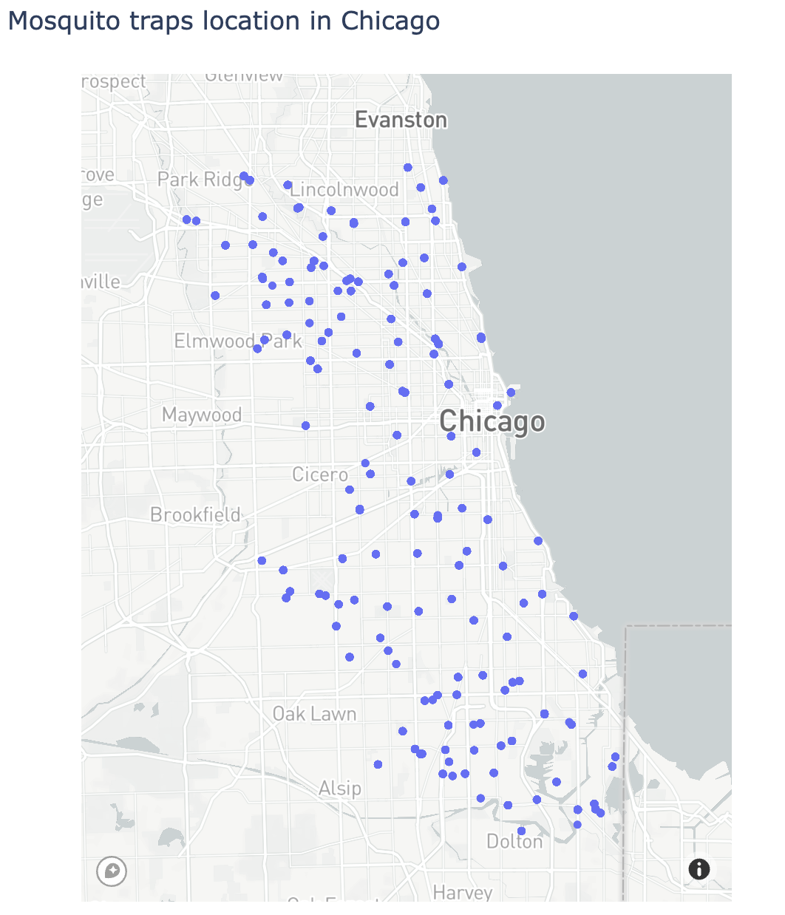
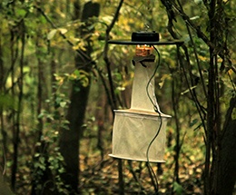
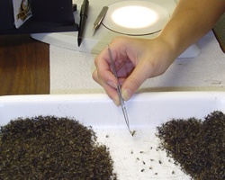
How is the data created?
mosquitos in traps
Time
Location
Mosquitoes:
numbers
Species
Whether or not WNV is present

Slide 5
What is in the dataset?
mosquitos in traps
Time
Location
Mosquitoes in the pool :
Numbers of mosquitoes
Species of mosquitoes
Positivity result of the pool

Slide 6
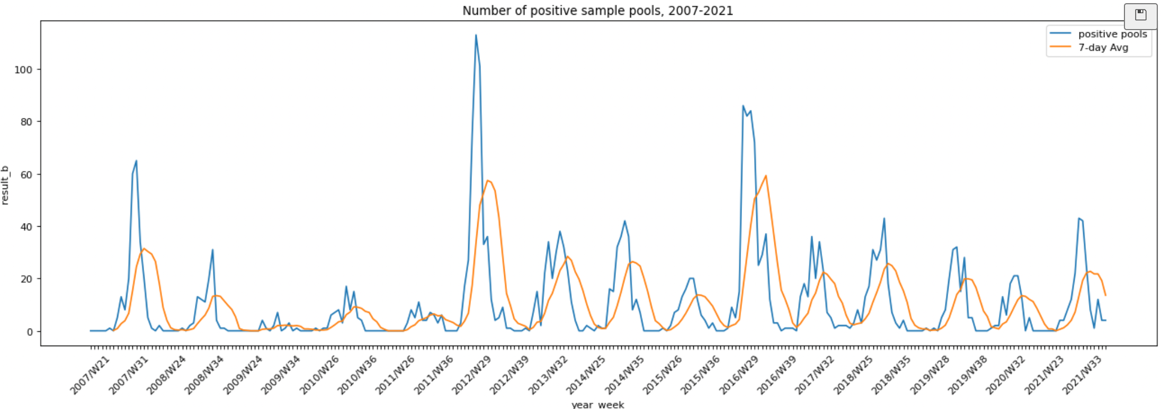
Overall positive pools by week of years
1. periodic pattern

Slide 7
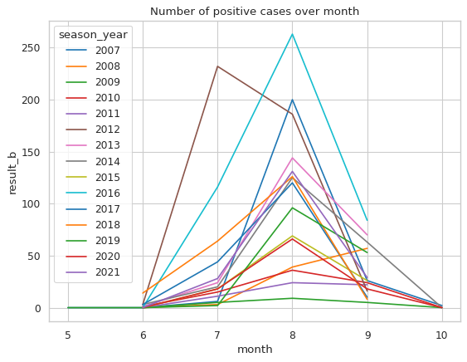
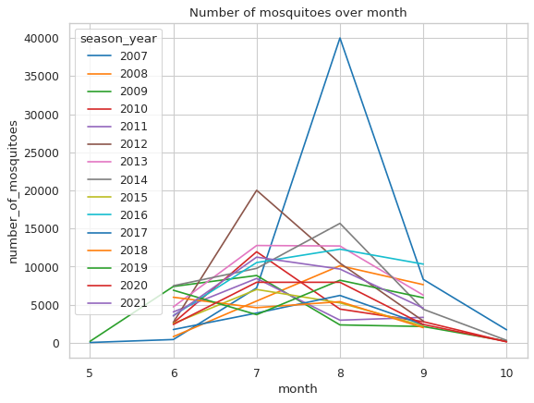
EDA - seasonality
Both peak in July and August

Slide 8
Overall positive pools by week of years
1. periodic pattern 2. Peaks of 7-day average go up

Slide 9
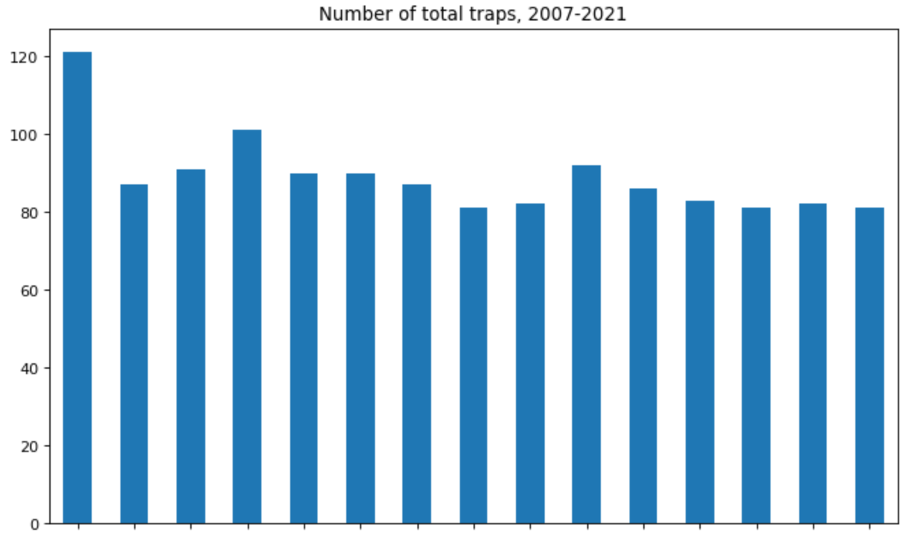
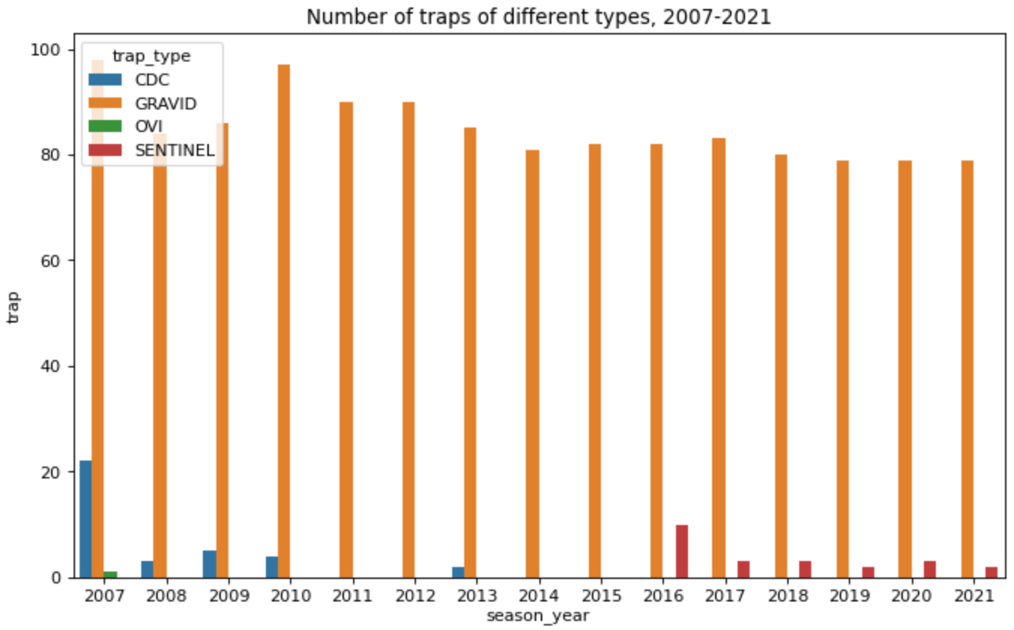
Number of traps

Slide 10
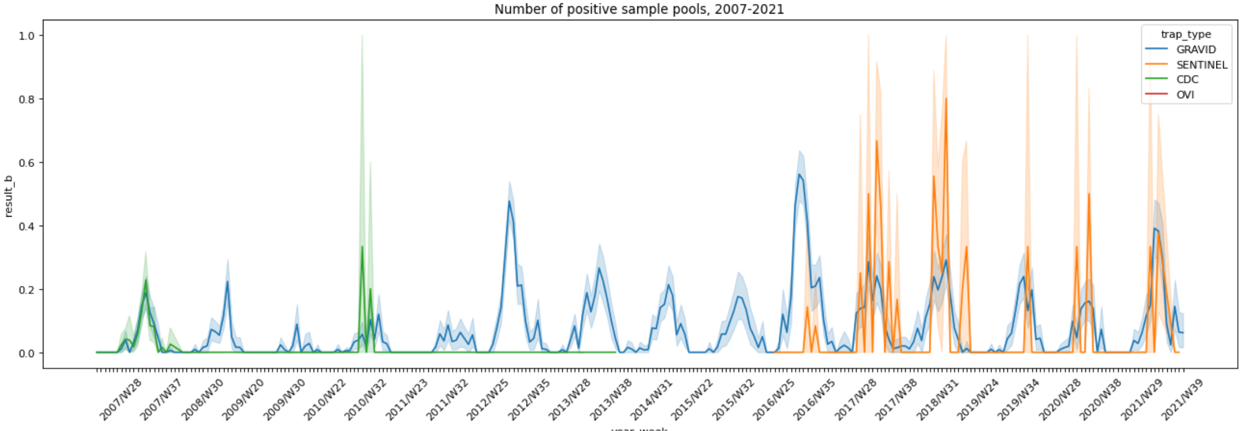
Selection bias?
Sentinel traps replace CDC traps

Slide 11
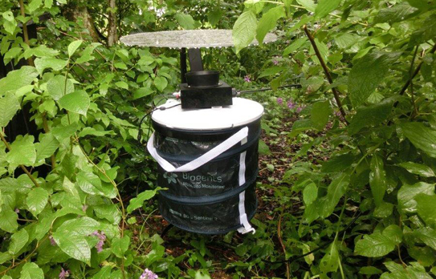
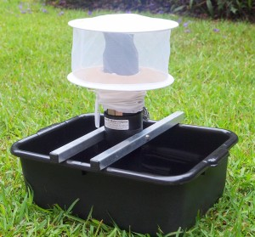
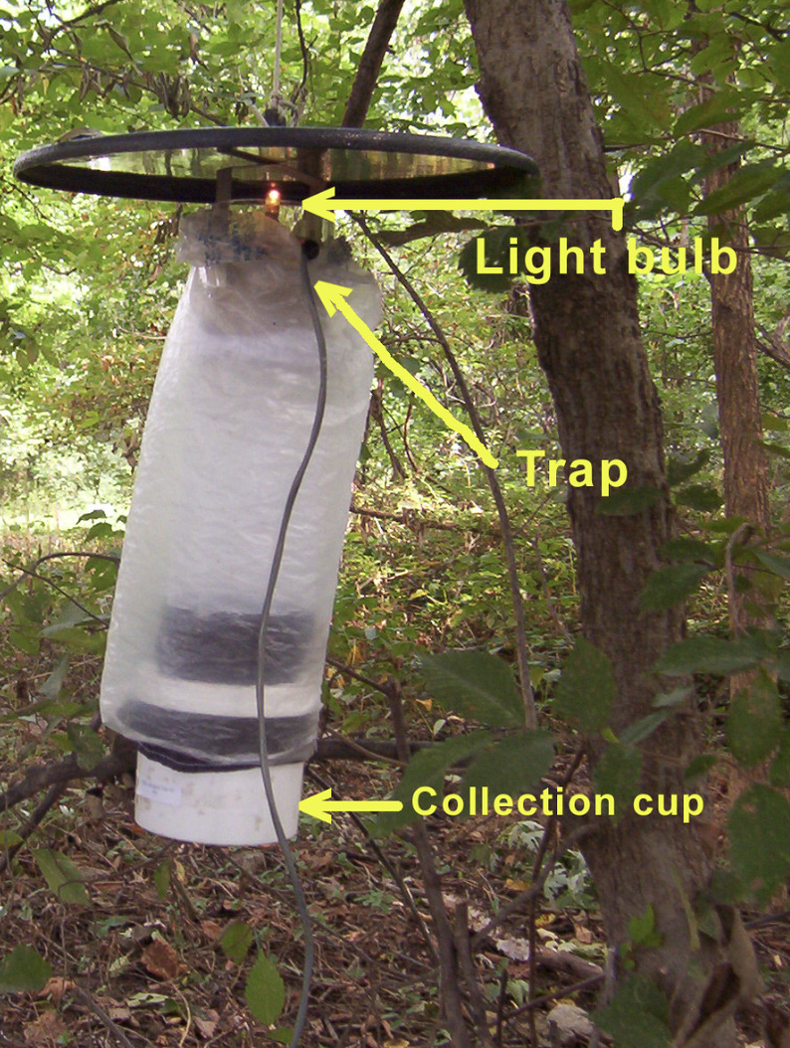
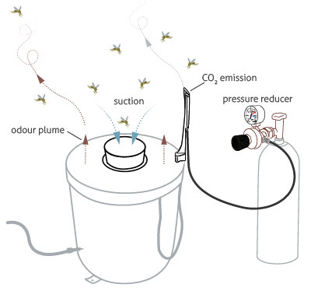
Trap types
Active
Passive
Sentinel
Gravid
CDC

Slide 12
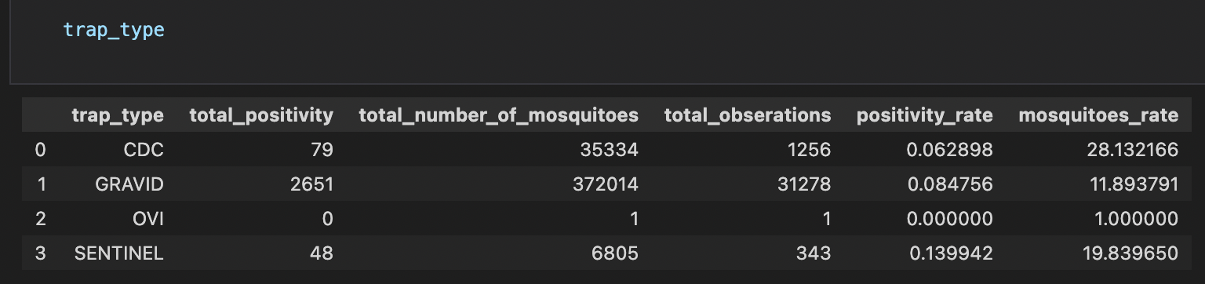
Selection bias
CDC traps might capture more mosquitoes
Sentinel traps might capture more positive moquitoes

Slide 13
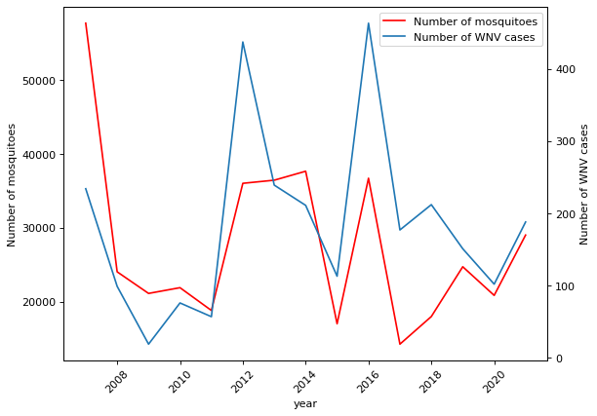
EDA - cases over years
Fluctuates
Very likely correlation between positivity and number of mosquitos

Slide 14
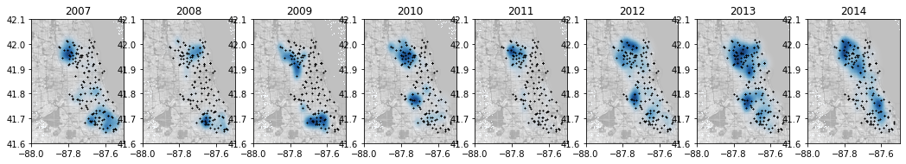
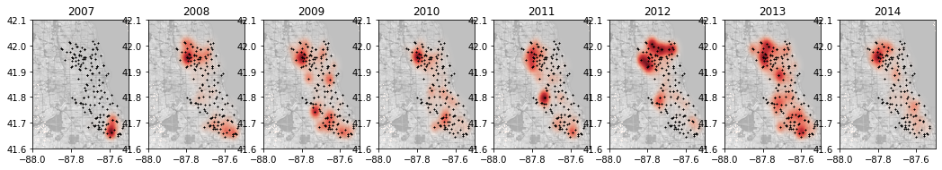
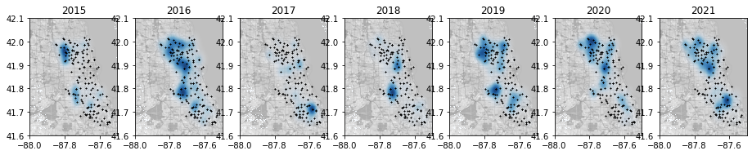
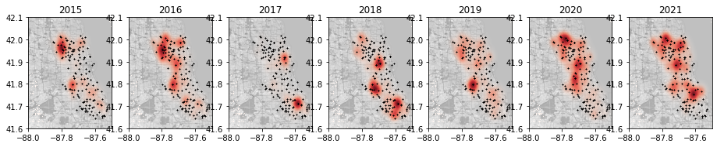
2007~2021
EDA - kernel density
Blue: positivity
Red: number of sample collected

Slide 15
2007~2021
Peaks in samples and cases are not often related in space
Blue: positivity
Red: number of sample collected

Slide 16
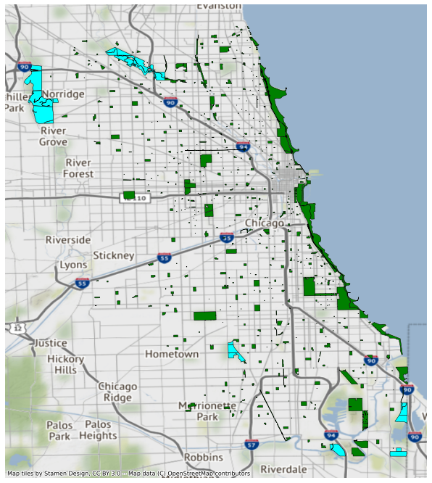
Spatial feature with geology component
Distance to nearest：
Parks
Forests
Water
311 sanitation violation
Temperature & precipitation
NOAA weather data

Slide 17
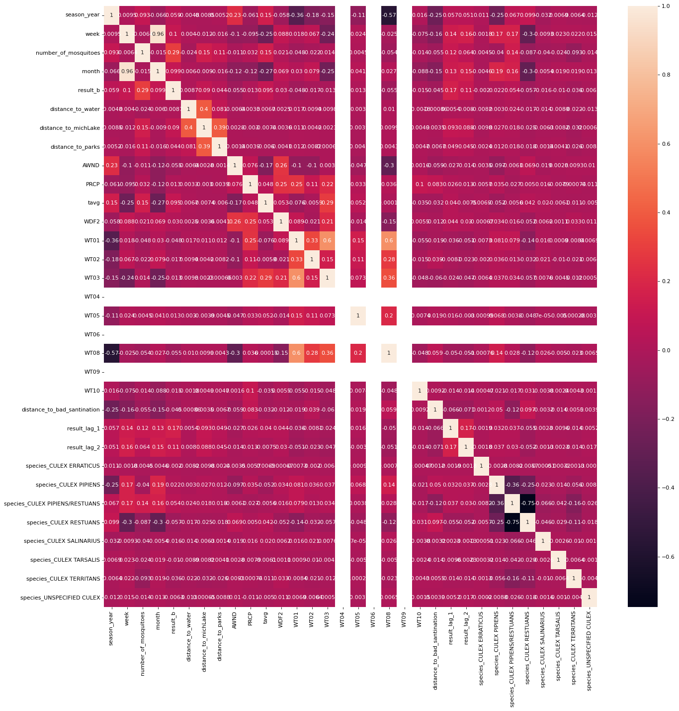
Model
No much
Multicollinearity
Temperature
precipitation
Weather type
Temporal lag
Species

Slide 18
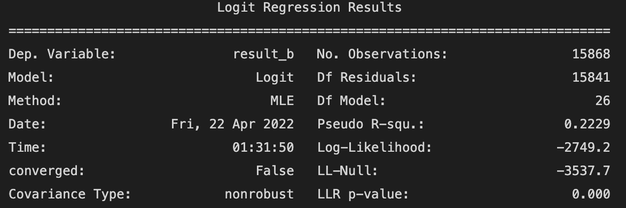
Logistic model

Slide 19
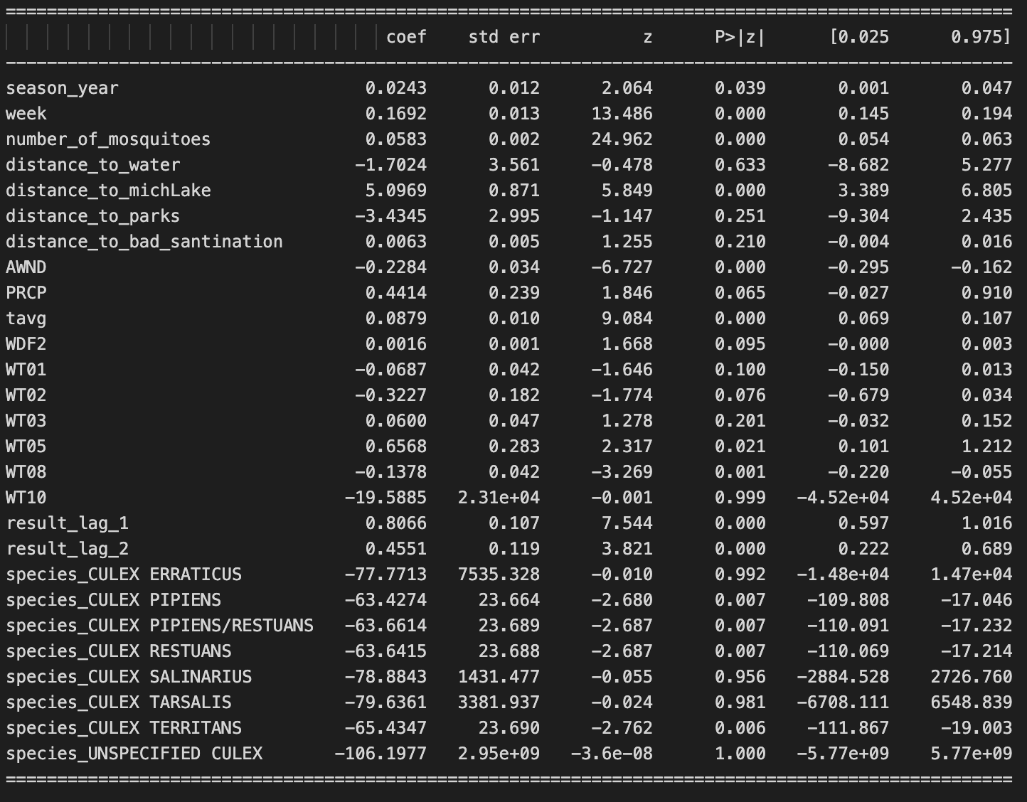
Logistic model
High P-value:
Distance to Lake Michigan
Average wind speed
Average temperature
Temporal lag

Slide 20
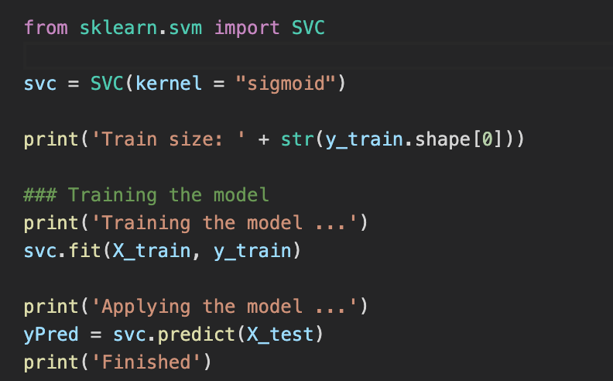
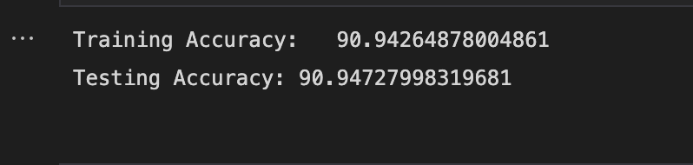
Support vector machine (SVM) classification

Slide 21
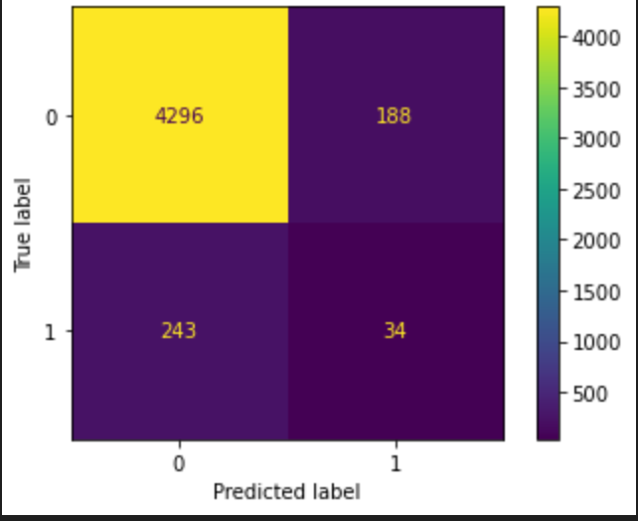
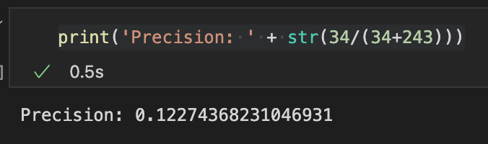
Support vector machine (SVM) classification
Low precision

Slide 22
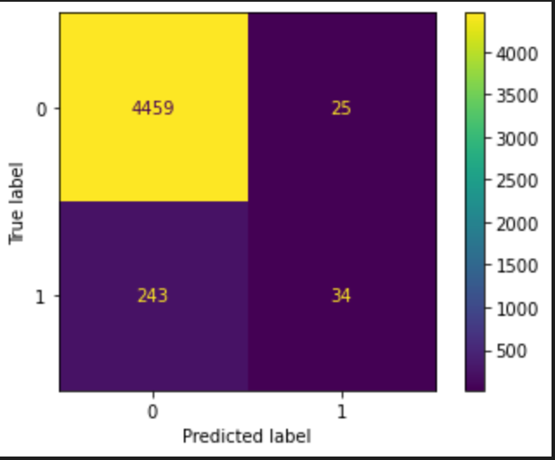
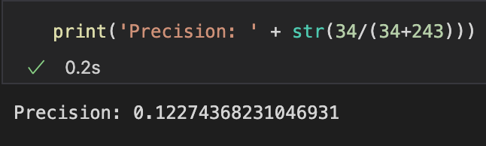
Random forest classification
Same low precision

Slide 23
Next steps
1. Tune models
2. Add wind influences

Slide 24
Spatial lag with wind
Feature engineering:
spatialLag1 = [ (Positivity * # Mosquito) * Speed * cosθ / Distance] + [….]
The component vector of wind in the direction of traps
(Same as other upwind trap)
in a upwind trap
(from the last collecting time)
wind

Slide 25
Spatial lag with wind (next step)
Feature engineering:
spatialLag1 = [ (Positivity * # Mosquito) * Speed / Distance] + [….]
- Wind directions simplified as eight compass points: N, NE, E, SE, S, SW, W, NW.

Slide 26
Thank you!

